Slide 1

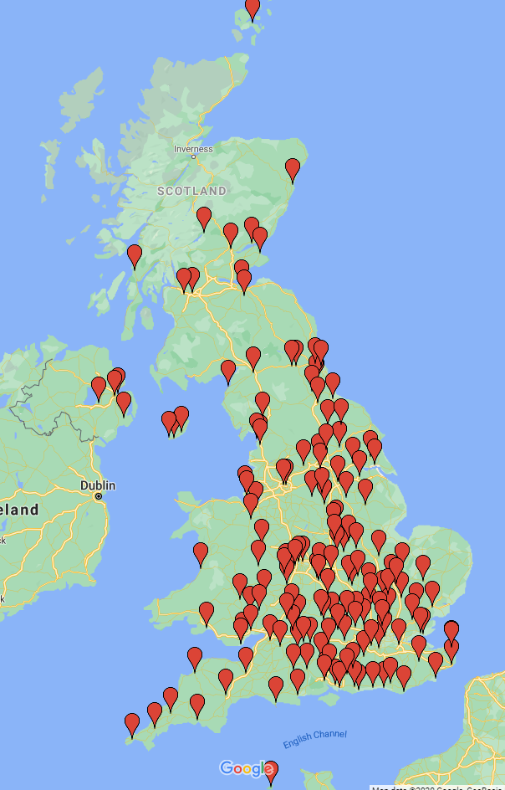
Nov 2024 - Nov 2025 Membership
266 active members
227 England
13 Wales
12 Scotland
6 Northern Ireland
- 8 Rest of the World
22 new members 4 Institutional, 3 Student, 15 Full

